Slide 1

6th Grade Math
Unit 12, Lesson 8 Solving One-Step Equations in One Variable Using Addition and Subtraction – Part 2 Volume 2, pg. 320

Slide 2


Benchmark
MA.6.AR.2.2
Write and solve one-step equations in one variable within a mathematical or real-world context using addition and subtraction, where all terms and solutions are integers.
volume 2, pg. 320

Slide 3
Integrated Mathematical Thinking and Reasoning Standards
MA.K12.MTR.1.1 Actively participate in effortful learning both individually and collectively.
MA.K12.MTR.2.1 Demonstrate understanding by representing problems in multiple ways.
MA.K12.MTR.4.1 Engage in discussions that reflect on the mathematical thinking of self and others.
MA.K12.MTR.5.1 Use patterns and structure to help understand and connect mathematical concepts.
MA.K12.MTR.6.1 Assess the reasonableness of solutions.
volume 2, pg. 320

Slide 4

Learning Target
I can solve addition and subtraction one-step equations.
volume 2, pg. 320

Slide 5

Warm-Up
volume 2, pg. 320

Slide 6
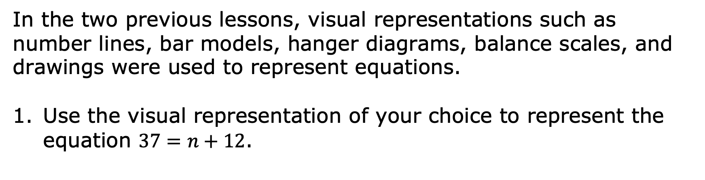
12.8.1 Warm-Up: Visualizing Solutions
volume 2, pg. 320

Slide 7
Find the value of 𝑛.
volume 2, pg. 320

Slide 8

Collaboration
volume 2, pg. 321

Slide 9
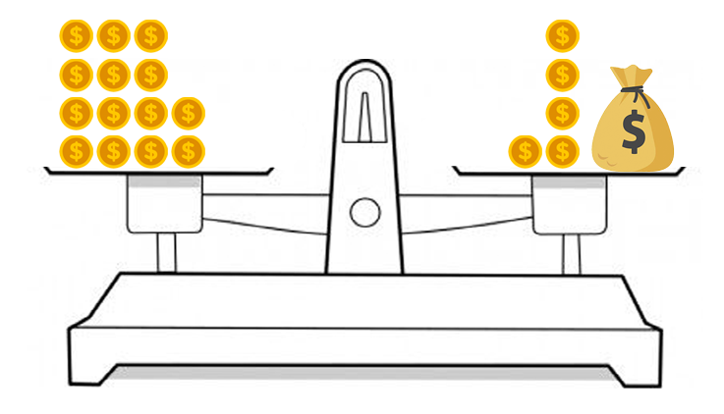
12.8.2 Collaboration: Algebraic Equations from a Diagram
Ellen and Frey were given the balance scale shown below, and told to write and solve an algebraic equation using inverse operations.
volume 2, pg. 321

Slide 10
Ellen said, “There’s no way to write an algebraic equation. If we can write an algebraic equation, we do not need inverse operations to solve it.”
Frey said, “The only way to solve an algebraic equation is to use inverse operations to show the math is being reversed.”
Whose statement do you agree with and why? Explain your answer to your partner.
volume 2, pg. 321

Slide 11
Write the algebraic equation represented by the balance scale.
Solve the equation and show the steps you took.
How many gold coins are in the bag? Compare your answer with your partner.
volume 2, pg. 321

Slide 12
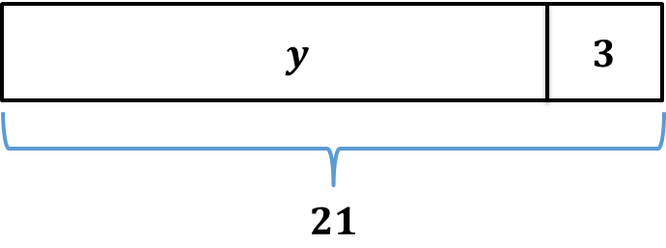
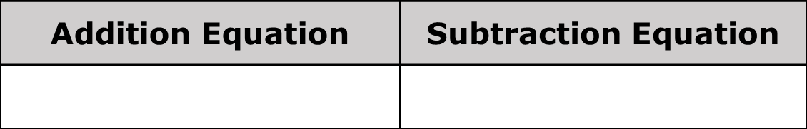
A bar model is shown.
Write an addition equation and a subtraction equation that can be represented by the bar model.
volume 2, pg. 322

Slide 13
Describe the relationship between the two equations.
Find the value of 𝑦 using either equation.
Check your solution with your partner. Make any revisions if necessary.
volume 2, pg. 322

Slide 14

Guided Practice
volume 2, pg. 322

Slide 15
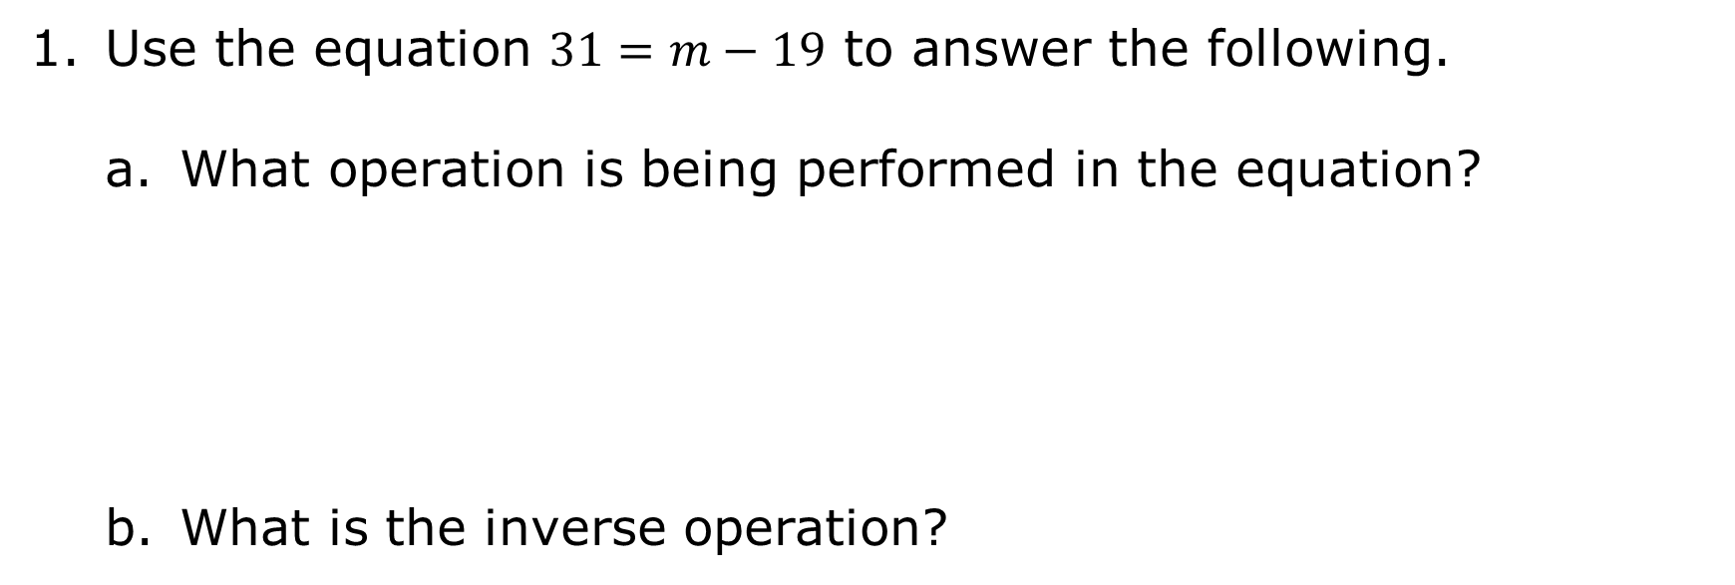
12.8.3 Guided Practice: Solving One-Step Algebraic Equations Using Inverse Operations
volume 2, pg. 322

Slide 16
Solve the equation using the inverse operation to find the value of 𝑚. Show your work.
Verify that the solution is correct by substituting the value found for 𝑚 into the original equation.
volume 2, pg. 322

Slide 17
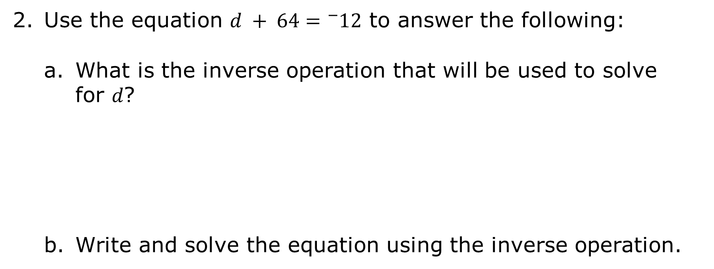
volume 2, pg. 323

Slide 18
What is the value of 𝑑?
Check your solution with your partner.
volume 2, pg. 323

Slide 19

Exploration
volume 2, pg. 323

Slide 20
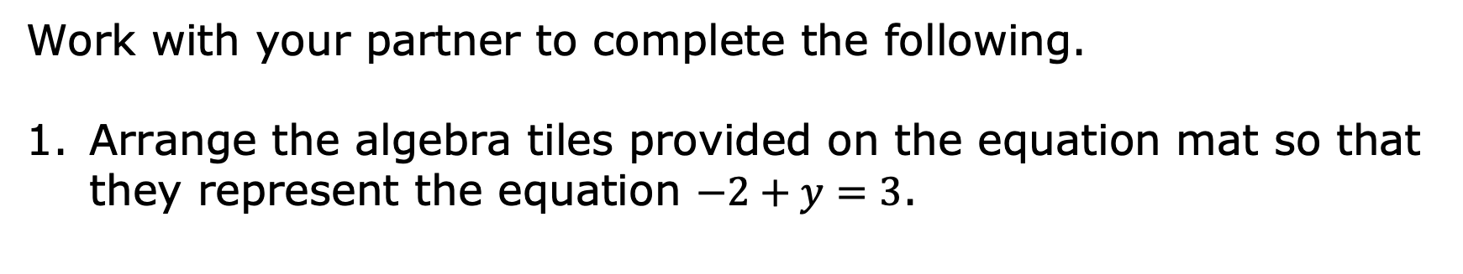
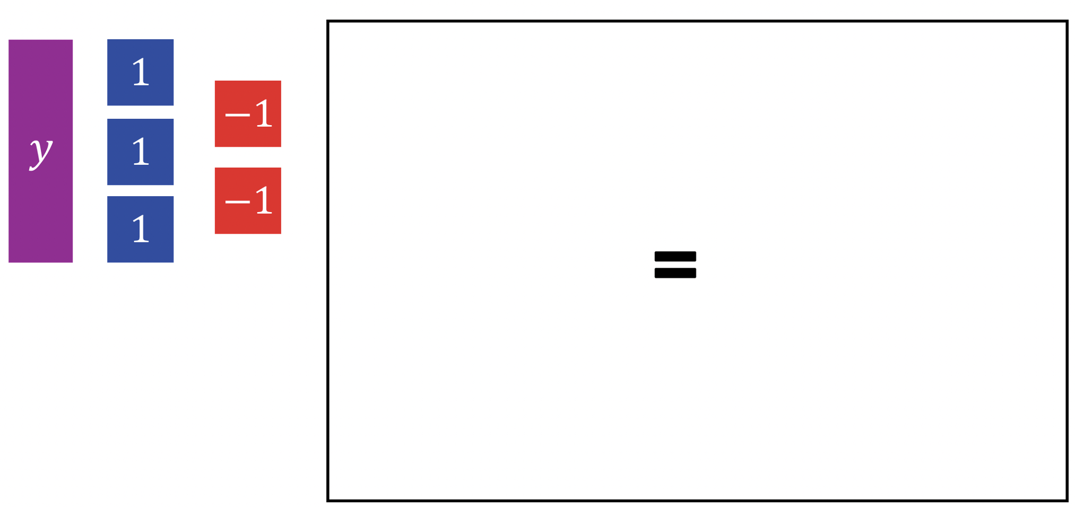
12.8.4 Exploration: Solving Equations Using Opposites
volume 2, pg. 323

Slide 21
Check your diagram with your partner.
For this equation, there are no tiles that can be removed from both sides of the equation to find the value of 𝑦.
Discuss with your partner how zero pairs could be used to find the value of 𝑦.
volume 2, pg. 323

Slide 22
The goal when solving an equation is to isolate the variable. Which tiles can be added to both sides of the equation so that all tiles other than 𝑦 on the left side of the equation can be eliminated?
Explain why, when tiles are added to one side of the equation, they also must be added to the other side.
volume 2, pg. 324

Slide 23
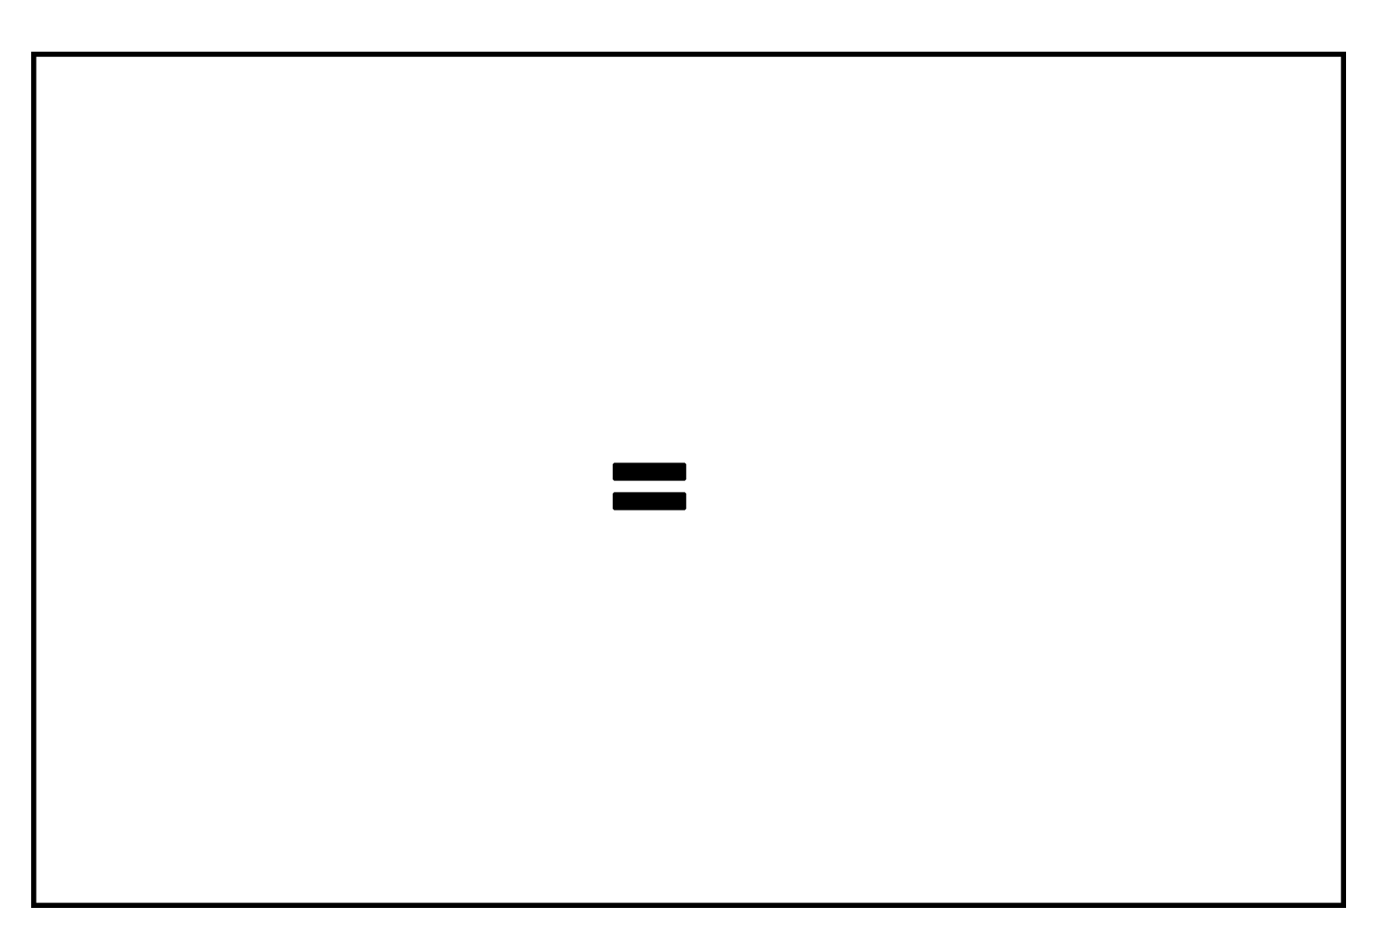

Draw tiles on the equation mat to represent the solution to the equation.
volume 2, pg. 324

Slide 24
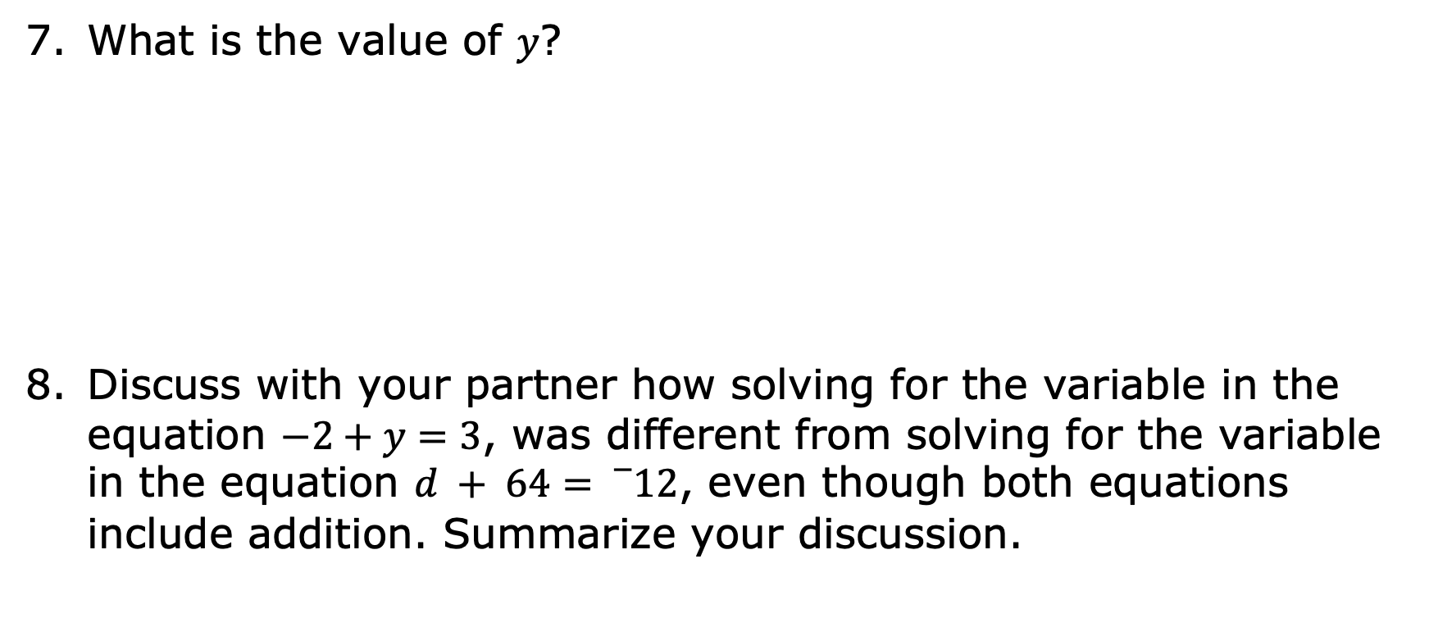
volume 2, pg. 324

Slide 25
Collaboration
volume 2, pg. 325

Slide 26
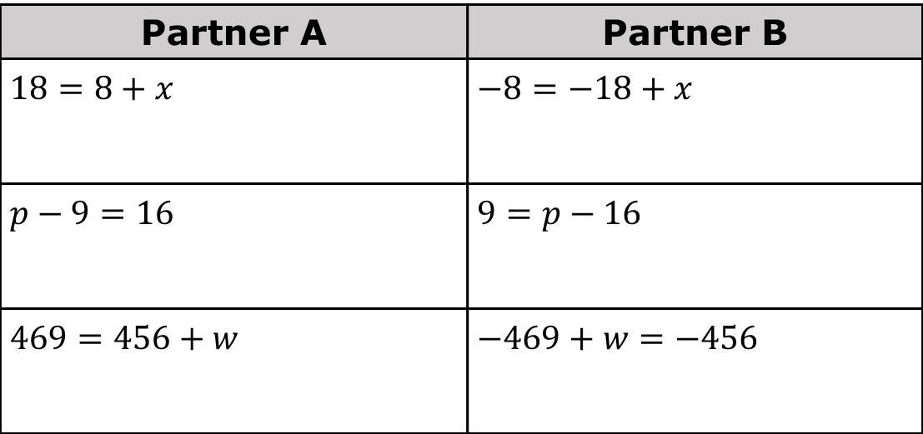
12.8.5 Collaboration: Solving Equations
With your partner, determine who will be Partner A and who will be Partner B.
Solve the equations from your designated column.
volume 2, pg. 325

Slide 27
The equations in each row have the same solutions. Check your work with your partner, making revisions to your work if necessary.
volume 2, pg. 325

Slide 28

Your Turn
volume 2, pg. 325

Slide 29
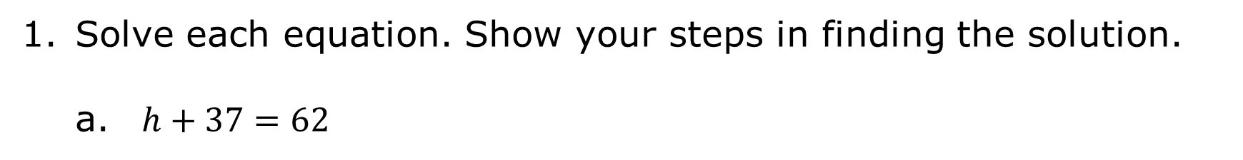
12.8.6 Your Turn!
volume 2, pg. 325

Slide 30
volume 2, pg. 325

Slide 31

Wrap-Up
volume 2, pg. 326

Slide 32
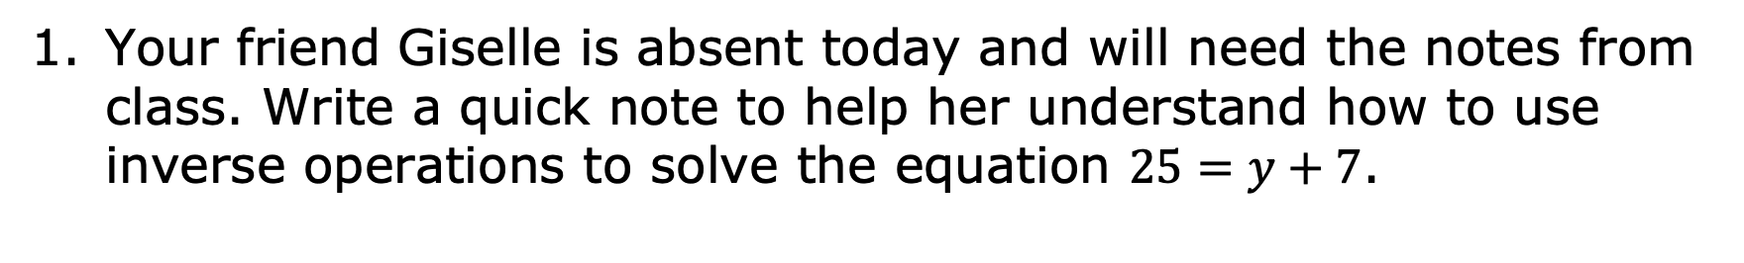
12.8.7 Wrap-Up: Cool Down
volume 2, pg. 326

